Slide 1


T03 - Follow the Breadcrumbs Azure Security Center In-Depth
Mike Nelson
Level: Beginner-Intermediate

Slide 2


Mike Nelson
Solutions Technologist @ Rubrik
@nelmedia
mike@mikenelson.io
Microsoft MVP, Azure Advisor, VMware vExpert, Citrix CTA

Slide 3

Topics
A couple of important things
Threat management in Azure
Investigations & hunting
*Great PowerShell scripts for ASC at the end of this deck!

Slide 4

Notes:
Curious questions for the audience

Slide 5

AZURE SECURITY CENTER (ASC)
Microsoft cloud workload protection platform to address the unique security requirements of Azure workloads and data center architectures that span on-premises and public cloud environments. Threat investigations in Azure can be complex & there are a lot of tools to utilize, including logging, analytics, monitoring, threat modeling, alerting, etc.

Slide 6
ATA, ATP, WDATP, etc…
Azure Threat Analytics
Azure Threat Protection
Windows Defender Advanced Threat Protection
O365 Advanced Threat Protection
On-prem solution (SKU)
Identity focused hybrid solution (E5)
Win10 (E5)
“Threat Experts”
Office apps (E5)

Slide 7

Multi-factor authentication
Data encryption
User accounts
Device log-ins
Malware
Unauthorized data access
Attacks
INTELLIGENCE
User log-ins
Phishing
Denial of service
Spam
System updates
Enterprise security
Notes:
Slide by Microsoft

Slide 8
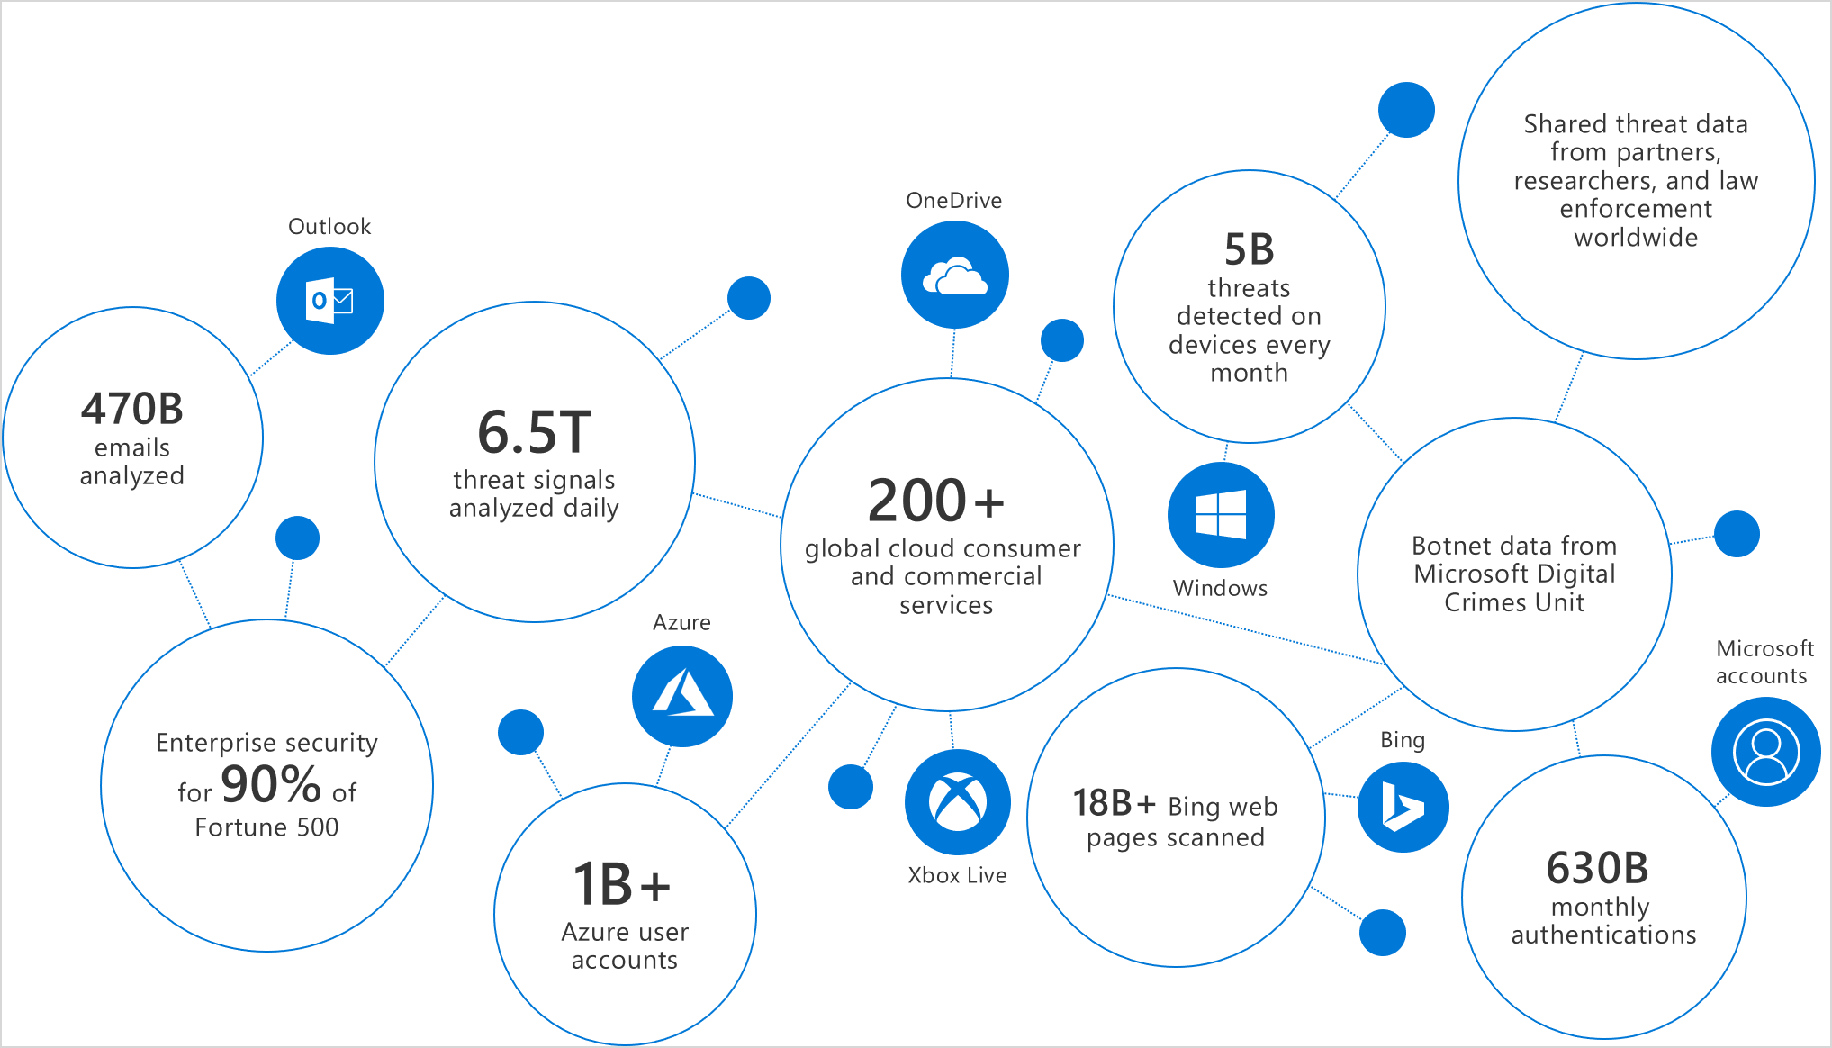
Intelligent Security Graph

Slide 9
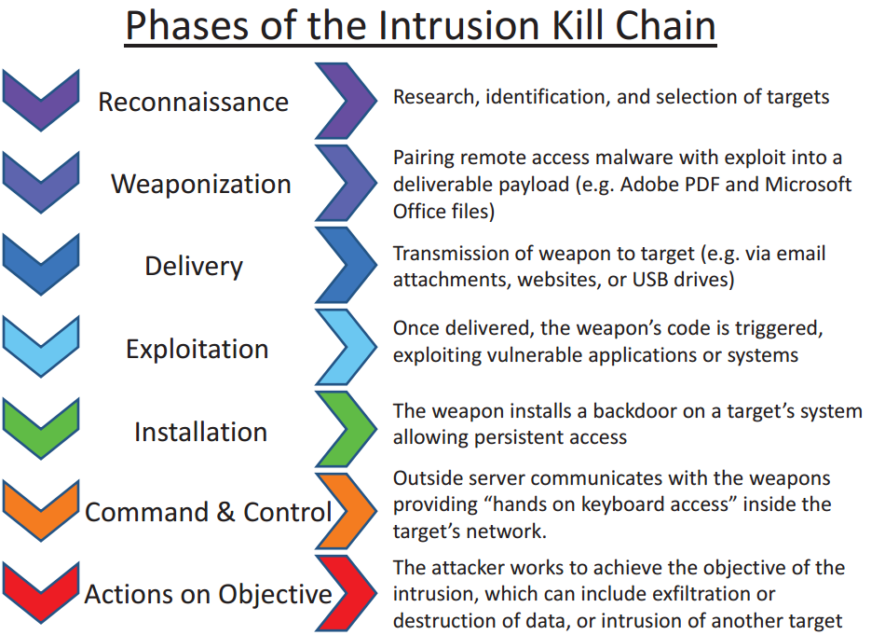
Cyber Kill Chain (aka Intrusion Kill Chain)
Notes:
Military Kill Chain –
Designed to be easy to remember, the "Four Fs" are as follows:
Find the enemy – Locate the enemy
Fix the enemy – Pin them down with suppressing fire
Fight the enemy – Engage the enemy in combat or flank the enemy – Send soldiers to the enemy's sides or rear
Finish the enemy – Eliminate all enemy combatants
The cyber kill chain is a series of steps that trace stages of a cyberattack from the early reconnaissance stages to the exfiltration of data. The kill chain helps us understand and combat ransomware, security breaches, and advanced persistent attacks (APTs)

Slide 10
Cloud Kill Chain (Microsoft’s view)
Target & attack
Install & exploit
Post breach
Inbound brute-force RDP. SSH, SQL attacks & more
In-memory malware & exploit attempts
Communication to a known malicious IP (data exfiltration or command & control)
Suspicious process execution
Applications & DDoS attacks
(WAF Partners)
Using compromised resources to mount additional attacks (outbound port scanning, brute-force RDP/SSH, DDoS, spam)
Lateral movement
Intrusion detection
(Network Gateway Firewall partners)
Internal reconnaissance
Notes:
The Unified Kill Chain consists of 18 unique attack phases that can occur in advanced cyber attacks.

Slide 11
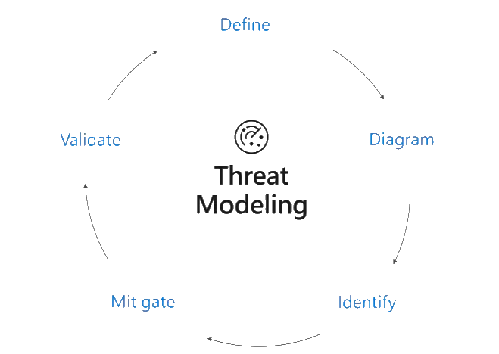
Cyber Kill Chain Defenses
Detect: determine whether an attacker is poking around
Deny: prevent information disclosure and unauthorized access
Disrupt: stop or change outbound traffic (to attacker)
Degrade: counter-attack command and control
Deceive: interfere with command and control
Contain: network segmentation changes
Microsoft’s Threat Modeling Tool

Slide 12
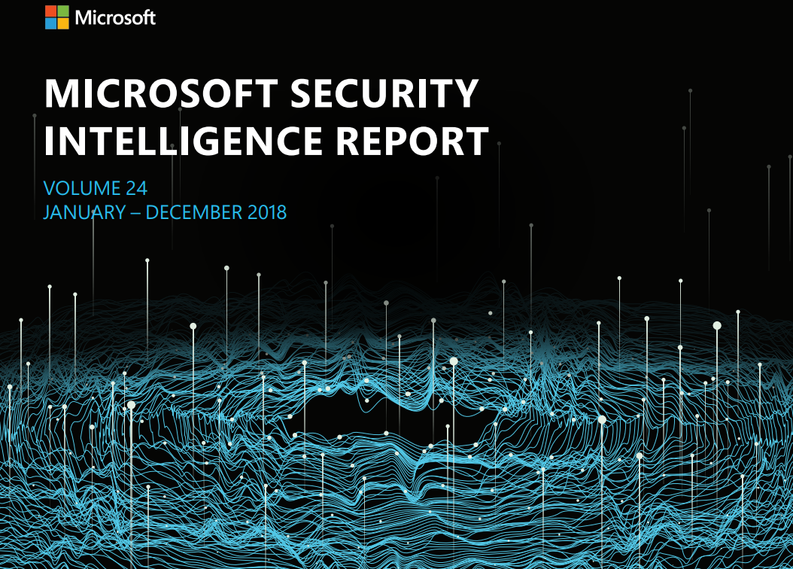
Notes:
Ransomware on decline
Cryptomining is the hot thing – BroCoiner
Phishing continues to be preferred method of attack
Poisoned extensions, malicious plug-ins, SMB attacks
Typo-squatting
Malicious Docker images
Which country has most malware attacks? (US not even in top 10)
Ethiopia
Pakistan
Palestinian countries
Primary origins of attacks?
China (largest state-sponsored hacking network in the world)
Ukraine/Belarus (Eastern Europe) (cyber-gangs)
Russia (state sponsored and gangs)

Slide 13
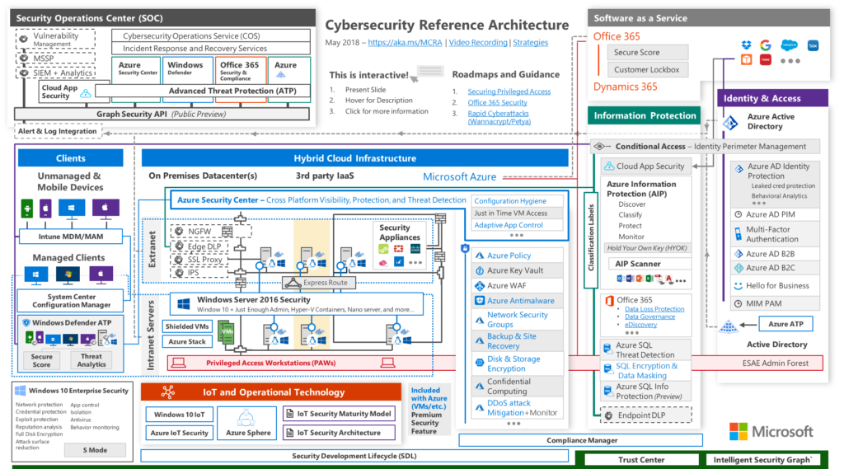
Notes:
Slide by Microsoft

Slide 14
Cloud security is a shared responsibility
Shared responsibility model for cloud security
Microsoft’s commitment
Joint responsibility
Secure foundation
Microsoft provides built-in controls
Physical assets
Virtual machines and networks
Datacenter operations
Apps and workloads
Cloud infrastructure
Data
Notes:
Slide by Microsoft

Slide 15


Security Center Architecture
Threat
Intelligence
Azure
Network & PaaS Netflow, SQL DB and Storage Logs, …
Azure Security Center
Security analytics
Threat Detections, Prescriptive Recommendations
Security Dashboards Deliver Rapid Insights into Security State Across All Workloads
Security Dashboards Deliver Rapid Insights into Security State Across All Workloads
Windows & Linux agents
Windows Events, Syslog, CEF, Configurations
Normalization & enrichment IP Geotagging, …
Actionable Security Recommendations
Curated, Prioritized Security Alerts
On-premises, private and public clouds
Scalable Log Analytics Platform
Investigation Tools and Log Search
Export to Excel and Power BI
REST APIs
Automation
Notifications
Notes:
Slide by Microsoft

Slide 16
Azure Logs
Source | Description | Config
ASC | ASC collects primarily from compute, both Azure VMs and non-Azure VMs. It utilizes a Monitoring Agent that reads logs and configs. All data is brought into a Workspace in Azure. | ASC Standard Tier *must* be enabled. Optional automated provisioning of agent or manual.
Network Security Gateways | NSG’s are virtual firewall applied to VMs, vNets, and subnets. Flow data can be collected here. | NSG Flow Logging should be enabled on the resource to ensure source IP’s are captured.
Virtual Machines | OS logs – event logs and syslog. Can be granular and custom. | Provision the agent.
Subscriptions & ARM | Activity Logs at the subscription/tenant tier | Subscriber or tenant level events
Azure Active Directory | User & group object activity at the Active Directory tier | All events are audited by default. Enable ATP.
PaaS Services (IIS, Azure Firewall, * Gateways, etc.) | Diagnostic logging for services. Example: general IIS is on by default, but can be customized | Enable diagnostic logging for service. CollectGuestLogs.exe (part of the guest agent on VMs) on the VM. Creates a zip file for download.
Notes:
Two primary logging aggregators in Azure – ASC and Monitor. Sentinel could be considered a third.

Slide 17
Automatic onboarding & extending to hybrid cloud
Azure
Seamless Azure integration
Automatically discovers and monitors security of Azure resources
Extensive log collection
Protect servers running on other clouds and on-premise
Automatic provisioning for Azure resources
Windows & Linux agents
Windows Events, Syslog, CEF, Configurations
On-premises, private and public clouds
Notes:
Slide by Microsoft

Slide 18
Attack timeline
1
2
Day 84 – 129:
Moves laterally through network; obtains privileged credentials and accesses sensitive systems.
3
Day 134:
Threat actor executes fraudulent transfers of funds.
Day 1:
Attackers successfully target Patient Zero with backdoor malware
LATERAL
MOVEMENT
EXFILTRATE DATA
DOMAIN DOMINANCE
DENIAL OF
ACCESS
5
4
Day 135:
Uses remote code execution from a local machine to domain controller, gaining domain admin accounts
Day 135:
After customer detects fraudulent transactions, wrecking ball malware is delivered. Operations are brought to a halt!

Slide 19

Anatomy of an attack-detected by Security Center
PORT SCANNING ACTIVITY DETECTED
BRUTE FORCE ACTIVITY DETECTED
SUSPICIOUS PROCESS EXECUTED ON VM
DNS DATA EXFILTRATION ACTIVITY DETECTED
KILL CHAIN INCIDENT GENERATED
Reconnaissance
Weaponization
Data Breach
Installation
Command & Control
Incident
response
Attacker port scans to look for potential victims
Attacker launches a brute force attack on targets and breaches exposed interfaces
Attacker installs custom malware on the VM
Malware contacts its command and control and sends the data over the DNS protocol
The VM owner receives the information and shuts down the VM
Attacker compiles a list of targets with open interfaces
Attacker injects blind SQL commands into the Virtual Machine (VM)
Malware activates and scans the VM for confidential information and data
Security incident is generated, information is compiled and sent to the VM owner

Slide 20

Azure Tools Focus for Security Investigations
ASC & dashboard solutions
Log Analytics
Advisor
Monitor
Sentinel
Advanced Threat Protection (ATP)
NSG Flow Logs

Slide 21

DEMOS

Slide 22

THANKS!
Any questions?
You can find me at
@nelmedia
mike@mikenelson.io

Slide 23
Scripting ASC Resource - Tiander Turpijn – Sr. PM @ Microsoft https://github.com/tianderturpijn/ASC

Slide 24
PowerShell
Get-AzureRmSubscription | foreach{Set-AzureRmSecurityAutoProvisioningSetting -Name default}
Get-AzureRmSubscription | foreach{Set-AzureRmSecurityContact -Name "default" -Email “blah@blah.com" -Phone “123-456-7890" -AlertAdmin –NotifyOnAlert}
Get-AzureRmSubscription | foreach{Set-AzureRmSecurityAutoPricingTier -Name default –PricingTier Standard}
Get-AzureRmSubscription | foreach{
$subid = $_.Id
Set-AzureRmSecurityWorkspaceSetting -Name default -Scope "/subscriptions/$subid" -WorkspaceId "/subscriptions/<subscriptionid>/resourcegroups/<rgname>/providers/microsoft.operationalinsights/workspaces/<workspacename>"
}

Slide 25
PowerShell
Get-AzureRmSubscription | foreach{
Set-AzureRmSecurityAutoProvisioningSetting -Name default
Set-AzureRmSecurityContact -Name "default" -Email “blah@blah.com" -Phone “123-456-7890" -AlertAdmin –NotifyOnAlert
Set-AzureRmSecurityAutoPricingTier -Name default –PricingTier Standard
$subid = $_.Id
Set-AzureRmSecurityWorkspaceSetting -Name default -Scope "/subscriptions/$subid" -WorkspaceId "/subscriptions/<subscriptionid>/resourcegroups/<rgname>/providers/microsoft.operationalinsights/workspaces/<workspacename>"
}

Slide 26
ARM
https://github.com/tianderturpijn/ASC/blob/master/ARM/configureASCnewAPI.json
{
"$schema": "https://schema.management.azure.com/schemas/2015-01-01/deploymentTemplate.json#",
"contentVersion": "1.0.0.0",
"parameters": {
"autoProvisioning":{
"type": "string",
"allowedValues": [
"On",
"Off"
],
"metadata": {
"description": "Turn automatic deployment by ASC of the MMA (OMS VM extension) on or off"
}
},
"workspaceName": {
"type": "string",
"metadata": {
"description": "Specify the name of your custom Log Analytics workspace to collect ASC data."
}
},
"workspaceSubscriptionId": {
"type": "string",
"metadata": {
"description": "Specify the subscriptionId where the custom Log Analytics workspace is deployed."
}
},
"workspaceResourceGroup": {
"type": "string",
"metadata": {
"description": "Specify the resource group where the custom Log Analytics workspace is deployed."
}
},
"emailSecurityContact":{
"type": "string",
"metadata": {
"description": "email address of the contact, in the form of john@doe.com"
}
},
"phoneSecurityContact":{
"type": "string",
"metadata": {
"description": "phone number of the Security Contact"
}
},
"alertNotifications":{
"type": "string",
"allowedValues": [
"On",
"Off"
],
"metadata": {
"description": "Send alert notifications to Security Contact"
}
},
"alertsToAdmin":{
"type": "string",
"allowedValues": [
"On",
"Off"
],
"metadata": {
"description": "Send alert notifications to Admins"
}
},
"securitySettings": {
"type": "string",
"allowedValues": [
"On",
"Off"
],
"metadata": {
"description": "Turn security policy settings On or Off."
}
}
},
"variables": {},
"resources": [
{
"type": "Microsoft.Security/autoProvisioningSettings",
"name": "default",
"apiVersion": "2017-08-01-preview",
"properties":{
"autoProvision": "[parameters('autoProvisioning')]"
}
},
{
"type": "Microsoft.Security/workspaceSettings",
"apiVersion": "2017-08-01-preview",
"name": "default",
"properties": {
"workspaceId": "[concat('/subscriptions/', parameters('workspaceSubscriptionId'), '/resourceGroups/', parameters('workspaceResourceGroup'), '/providers/Microsoft.OperationalInsights/workspaces/', parameters('workspaceName'))]",
"scope": "[subscription().id]"
}
},
{
"type": "Microsoft.Security/securityContacts",
"name": "default1",
"apiVersion": "2017-08-01-preview",
"properties":{
"email": "[parameters('emailSecurityContact')]",
"phone": "[parameters('phoneSecurityContact')]",
"alertNotifications": "[parameters('alertNotifications')]",
"alertsToAdmins": "[parameters('alertsToAdmin')]"
}
},
{
"type": "Microsoft.Security/policies",
"apiVersion": "2015-06-01-preview",
"name": "default",
"properties": {
"policyLevel": "Subscription",
"name": "default",
"unique": "Off",
"logCollection": "Off",
"recommendations": {
"patch": "[parameters('securitySettings')]",
"baseline": "[parameters('securitySettings')]",
"antimalware": "[parameters('securitySettings')]",
"diskEncryption": "[parameters('securitySettings')]",
"acls": "[parameters('securitySettings')]",
"nsgs": "[parameters('securitySettings')]",
"waf": "[parameters('securitySettings')]",
"sqlAuditing": "[parameters('securitySettings')]",
"sqlTde": "[parameters('securitySettings')]",
"ngfw": "[parameters('securitySettings')]",
"vulnerabilityAssessment": "[parameters('securitySettings')]",
"storageEncryption": "[parameters('securitySettings')]",
"jitNetworkAccess": "[parameters('securitySettings')]"
},
"pricingConfiguration": {
"selectedPricingTier": "Standard"
}
}
}
],
"outputs": {}
}
{
"$schema": "https://schema.management.azure.com/schemas/2015-01-01/deploymentTemplate.json#",
"contentVersion": "1.0.0.0",
"parameters": {
"autoProvisioning":{
"type": "string",
"allowedValues": [
"On",
"Off"
],
"metadata": {
"description": "Turn automatic deployment by ASC of the MMA (OMS VM extension) on or off"
}
},
"workspaceName": {
"type": "string",
"metadata": {
"description": "Specify the name of your custom Log Analytics workspace to collect ASC data."
}
},
"workspaceSubscriptionId": {
"type": "string",
"metadata": {
"description": "Specify the subscriptionId where the custom Log Analytics workspace is deployed."
}
},
"workspaceResourceGroup": {
"type": "string",
"metadata": {
"description": "Specify the resource group where the custom Log Analytics workspace is deployed."
}
},
"emailSecurityContact":{
"type": "string",
"metadata": {
"description": "email address of the contact, in the form of john@doe.com"
}
},
"phoneSecurityContact":{
"type": "string",
"metadata": {
"description": "phone number of the Security Contact"
}
},
"alertNotifications":{
"type": "string",
"allowedValues": [
"On",
"Off"
],
"metadata": {
"description": "Send alert notifications to Security Contact"
}
},
"alertsToAdmin":{
"type": "string",
"allowedValues": [
"On",
"Off"
],
"metadata": {
"description": "Send alert notifications to Admins"
}
},
"securitySettings": {
"type": "string",
"allowedValues": [
"On",
"Off"
],
"metadata": {
"description": "Turn security policy settings On or Off."
}
}
},
"variables": {},
"resources": [
{
"type": "Microsoft.Security/autoProvisioningSettings",
"name": "default",
"apiVersion": "2017-08-01-preview",
"properties":{
"autoProvision": "[parameters('autoProvisioning')]"
}
},
{
"type": "Microsoft.Security/workspaceSettings",
"apiVersion": "2017-08-01-preview",
"name": "default",
"properties": {
"workspaceId": "[concat('/subscriptions/', parameters('workspaceSubscriptionId'), '/resourceGroups/', parameters('workspaceResourceGroup'), '/providers/Microsoft.OperationalInsights/workspaces/', parameters('workspaceName'))]",
"scope": "[subscription().id]"
}
},
{
"type": "Microsoft.Security/securityContacts",
"name": "default1",
"apiVersion": "2017-08-01-preview",
"properties":{
"email": "[parameters('emailSecurityContact')]",
"phone": "[parameters('phoneSecurityContact')]",
"alertNotifications": "[parameters('alertNotifications')]",
"alertsToAdmins": "[parameters('alertsToAdmin')]"
}
},
{
"type": "Microsoft.Security/policies",
"apiVersion": "2015-06-01-preview",
"name": "default",
"properties": {
"policyLevel": "Subscription",
"name": "default",
"unique": "Off",
"logCollection": "Off",
"recommendations": {
"patch": "[parameters('securitySettings')]",
"baseline": "[parameters('securitySettings')]",
"antimalware": "[parameters('securitySettings')]",
"diskEncryption": "[parameters('securitySettings')]",
"acls": "[parameters('securitySettings')]",
"nsgs": "[parameters('securitySettings')]",
"waf": "[parameters('securitySettings')]",
"sqlAuditing": "[parameters('securitySettings')]",
"sqlTde": "[parameters('securitySettings')]",
"ngfw": "[parameters('securitySettings')]",
"vulnerabilityAssessment": "[parameters('securitySettings')]",
"storageEncryption": "[parameters('securitySettings')]",
"jitNetworkAccess": "[parameters('securitySettings')]"
},
"pricingConfiguration": {
"selectedPricingTier": "Standard"
}
}
}
],
"outputs": {}
}

Slide 27
PowerShell – Management Groups and Policy
$root = Get-AzureRmManagementGroup -GroupName root
New-AzureRmManagementGroup -GroupName BusApps -DisplayName "Business Applications" -ParentId $root.Id
Get-AzureRmSubscription | New-AzureRmManagementGroupSubscription -GroupName BusApps

Slide 28
PowerShell – Management Groups and Policy
$MG = Get-AzureRmManagementGroup -GroupName BusApps
$Settings = @{
"systemUpdatesMonitoringEffect" = "AuditIfNotExists"
"systemConfigurationsMonitoringEffect" = "AuditIfNotExists"
"endpointProtectionMonitoringEffect" = "AuditIfNotExists"
"diskEncryptionMonitoringEffect" = "AuditIfNotExists"
"networkSecurityGroupsMonitoringEffect" = "AuditIfNotExists"
"webApplicationFirewallMonitoringEffect" = "AuditIfNotExists"
"nextGenerationFirewallMonitoringEffect" = "AuditIfNotExists"
"vulnerabilityAssesmentMonitoringEffect" = "AuditIfNotExists"
"storageEncryptionMonitoringEffect" = "Audit"
"jitNetworkAccessMonitoringEffect" = "AuditIfNotExists"
"adaptiveApplicationControlsMonitoringEffect" = "AuditIfNotExists"
"sqlAuditingMonitoringEffect" = "AuditIfNotExists"
"sqlEncryptionMonitoringEffect" = "AuditIfNotExists"
"diagnosticsLogsInAppServiceMonitoringEffect" = "Audit"
"encryptionOfAutomationAccountMonitoringEffect" = "Audit"
"diagnosticsLogsInBatchAccountMonitoringEffect" = "AuditIfNotExists"
"diagnosticsLogsInBatchAccountRetentionDays" = "365"
"metricAlertsInBatchAccountMonitoringEffect" = "AuditIfNotExists"
"classicComputeVMsMonitoringEffect" = "Audit"
"classicStorageAccountsMonitoringEffect" = "Audit"
"diagnosticsLogsInDataLakeAnalyticsMonitoringEffect" = "AuditIfNotExists"
"diagnosticsLogsInDataLakeAnalyticsRetentionDays" = "Audit"
"diagnosticsLogsInDataLakeStoreMonitoringEffect" = "AuditIfNotExists"
"diagnosticsLogsInDataLakeStoreRetentionDays" = "Audit"
"diagnosticsLogsInEventHubMonitoringEffect" = "AuditIfNotExists"
"diagnosticsLogsInEventHubRetentionDays" = "Audit"
"diagnosticsLogsInKeyVaultMonitoringEffect" = "AuditIfNotExists"
"diagnosticsLogsInKeyVaultRetentionDays" = "365"
"diagnosticsLogsInLogicAppsMonitoringEffect" = "AuditIfNotExists"
"diagnosticsLogsInLogicAppsRetentionDays" = "365"
"diagnosticsLogsInRedisCacheMonitoringEffect" = "Audit"
"diagnosticsLogsInSearchServiceMonitoringEffect" = "AuditIfNotExists"
"diagnosticsLogsInSearchServiceRetentionDays" = "365"
"aadAuthenticationInServiceFabricMonitoringEffect" = "Audit"
"clusterProtectionLevelInServiceFabricMonitoringEffect" = "Audit"
"diagnosticsLogsInServiceBusMonitoringEffect" = "AuditIfNotExists"
"diagnosticsLogsInServiceBusRetentionDays" = "365"
"namespaceAuthorizationRulesInServiceBusMonitoringEffect" = "Audit"
"aadAuthenticationInSqlServerMonitoringEffect" = "AuditIfNotExists"
"secureTransferToStorageAccountMonitoringEffect" = "Audit"
"diagnosticsLogsInStreamAnalyticsMonitoringEffect" = "AuditIfNotExists"
"diagnosticsLogsInStreamAnalyticsRetentionDays" = "365"
"useRbacRulesMonitoringEffect" = "Audit"
"disableUnrestrictedNetworkToStorageAccountMonitoringEffect" = "Audit"
"diagnosticsLogsInServiceFabricMonitoringEffect" = "AuditIfNotExists"
"accessRulesInEventHubNamespaceMonitoringEffect" = "Audit"
"accessRulesInEventHubMonitoringEffect" = "AuditIfNotExists"
"sqlDbVulnerabilityAssesmentMonitoringEffect" = "AuditIfNotExists"
"identityDesignateLessThanOwnersMonitoringEffect" = "AuditIfNotExists"
"identityDesignateMoreThanOneOwnerMonitoringEffect" = "AuditIfNotExists"
"identityEnableMFAForOwnerPermissionsMonitoringEffect" = "AuditIfNotExists"
"identityEnableMFAForWritePermissionsMonitoringEffect" = "AuditIfNotExists"
"identityEnableMFAForReadPermissionsMonitoringEffect" = "AuditIfNotExists"
"identityRemoveDeprecatedAccountWithOwnerPermissionsMonitoringEffect" = "AuditIfNotExists"
"identityRemoveDeprecatedAccountMonitoringEffect" = "AuditIfNotExists"
"identityRemoveExternalAccountWithOwnerPermissionsMonitoringEffect" = "AuditIfNotExists"
"identityRemoveExternalAccountWithWritePermissionsMonitoringEffect" = "AuditIfNotExists"
"identityRemoveExternalAccountWithReadPermissionsMonitoringEffect" = "AuditIfNotExists"
}
$ASCPolicy = Get-AzureRmPolicySetDefinition | where {$_.Properties.Displayname -eq "[Preview]: Enable Monitoring in Azure Security Center"}
New-AzureRmPolicyAssignment -Name "EnableASC" -DisplayName "Enable Azure Security Center" -Scope $MG.Id -PolicySetDefinition $ASCPolicy -PolicyParameterObject $Settings

Slide 29
PowerShell
$Settings = @{
"systemUpdatesMonitoringEffect" = "AuditIfNotExists"
"systemConfigurationsMonitoringEffect" = "AuditIfNotExists"
"endpointProtectionMonitoringEffect" = "AuditIfNotExists"
"diskEncryptionMonitoringEffect" = "AuditIfNotExists"
"networkSecurityGroupsMonitoringEffect" = "AuditIfNotExists"
"webApplicationFirewallMonitoringEffect" = "AuditIfNotExists"
"nextGenerationFirewallMonitoringEffect" = "AuditIfNotExists"
"vulnerabilityAssesmentMonitoringEffect" = "AuditIfNotExists"
"storageEncryptionMonitoringEffect" = "Audit"
"jitNetworkAccessMonitoringEffect" = "AuditIfNotExists"
"adaptiveApplicationControlsMonitoringEffect" = "AuditIfNotExists"
"sqlAuditingMonitoringEffect" = "AuditIfNotExists"
"sqlEncryptionMonitoringEffect" = "AuditIfNotExists"
"diagnosticsLogsInAppServiceMonitoringEffect" = "Audit"
"encryptionOfAutomationAccountMonitoringEffect" = "Audit"
"diagnosticsLogsInBatchAccountMonitoringEffect" = "AuditIfNotExists"
"diagnosticsLogsInBatchAccountRetentionDays" = "365"
"metricAlertsInBatchAccountMonitoringEffect" = "AuditIfNotExists"
"classicComputeVMsMonitoringEffect" = "Audit"
"classicStorageAccountsMonitoringEffect" = "Audit"
"diagnosticsLogsInDataLakeAnalyticsMonitoringEffect" = "AuditIfNotExists"
"diagnosticsLogsInDataLakeAnalyticsRetentionDays" = "Audit"
"diagnosticsLogsInDataLakeStoreMonitoringEffect" = "AuditIfNotExists"
"diagnosticsLogsInDataLakeStoreRetentionDays" = "Audit"
"diagnosticsLogsInEventHubMonitoringEffect" = "AuditIfNotExists"
"diagnosticsLogsInEventHubRetentionDays" = "Audit"
"diagnosticsLogsInKeyVaultMonitoringEffect" = "AuditIfNotExists"
"diagnosticsLogsInKeyVaultRetentionDays" = "365"
"diagnosticsLogsInLogicAppsMonitoringEffect" = "AuditIfNotExists"
"diagnosticsLogsInLogicAppsRetentionDays" = "365"
"diagnosticsLogsInRedisCacheMonitoringEffect" = "Audit"
"diagnosticsLogsInSearchServiceMonitoringEffect" = "AuditIfNotExists"
"diagnosticsLogsInSearchServiceRetentionDays" = "365"
"aadAuthenticationInServiceFabricMonitoringEffect" = "Audit"
"clusterProtectionLevelInServiceFabricMonitoringEffect" = "Audit"
"diagnosticsLogsInServiceBusMonitoringEffect" = "AuditIfNotExists"
"diagnosticsLogsInServiceBusRetentionDays" = "365"
"namespaceAuthorizationRulesInServiceBusMonitoringEffect" = "Audit"
"aadAuthenticationInSqlServerMonitoringEffect" = "AuditIfNotExists"
"secureTransferToStorageAccountMonitoringEffect" = "Audit"
"diagnosticsLogsInStreamAnalyticsMonitoringEffect" = "AuditIfNotExists"
"diagnosticsLogsInStreamAnalyticsRetentionDays" = "365"
"useRbacRulesMonitoringEffect" = "Audit"
"disableUnrestrictedNetworkToStorageAccountMonitoringEffect" = "Audit"
"diagnosticsLogsInServiceFabricMonitoringEffect" = "AuditIfNotExists"
"accessRulesInEventHubNamespaceMonitoringEffect" = "Audit"
"accessRulesInEventHubMonitoringEffect" = "AuditIfNotExists"
"sqlDbVulnerabilityAssesmentMonitoringEffect" = "AuditIfNotExists"
"identityDesignateLessThanOwnersMonitoringEffect" = "AuditIfNotExists"
"identityDesignateMoreThanOneOwnerMonitoringEffect" = "AuditIfNotExists"
"identityEnableMFAForOwnerPermissionsMonitoringEffect" = "AuditIfNotExists"
"identityEnableMFAForWritePermissionsMonitoringEffect" = "AuditIfNotExists"
"identityEnableMFAForReadPermissionsMonitoringEffect" = "AuditIfNotExists"
"identityRemoveDeprecatedAccountWithOwnerPermissionsMonitoringEffect" = "AuditIfNotExists"
"identityRemoveDeprecatedAccountMonitoringEffect" = "AuditIfNotExists"
"identityRemoveExternalAccountWithOwnerPermissionsMonitoringEffect" = "AuditIfNotExists"
"identityRemoveExternalAccountWithWritePermissionsMonitoringEffect" = "AuditIfNotExists"
"identityRemoveExternalAccountWithReadPermissionsMonitoringEffect" = "AuditIfNotExists"
}

